Slide 1
Bank Management System
Group 21
19ucs210 Lakshay Agarwal
19ucs135 Somil Gupta
19ucs099 Prateek Jakhar
19dcs012 Nikita Saboo

Slide 2
Introduction
The project is based on an online bank management portal. It allows an existing user to login through his/her account number and pin and will prompt the user if the pin or account number is incorrect.
The user could perform various actions like deposit or withdraw money, view the balance, change the pin and get a mini statement for his/her transactions.
The login page also has a signup option for new users to create an account. The user has to fill in their credentials like Name, Father’s name, Address, Mobile number, Aadhar card number etc.

Slide 3
On submitting the form, an account number and pin is generated automatically and given to the user.
The user then has to deposit the minimum balance to his/her account which is 3000 and will prompt the user if the deposited balance is less than 3000 Rs.
The user can then use these credentials to login to his/her account and perform various actions.

Slide 4
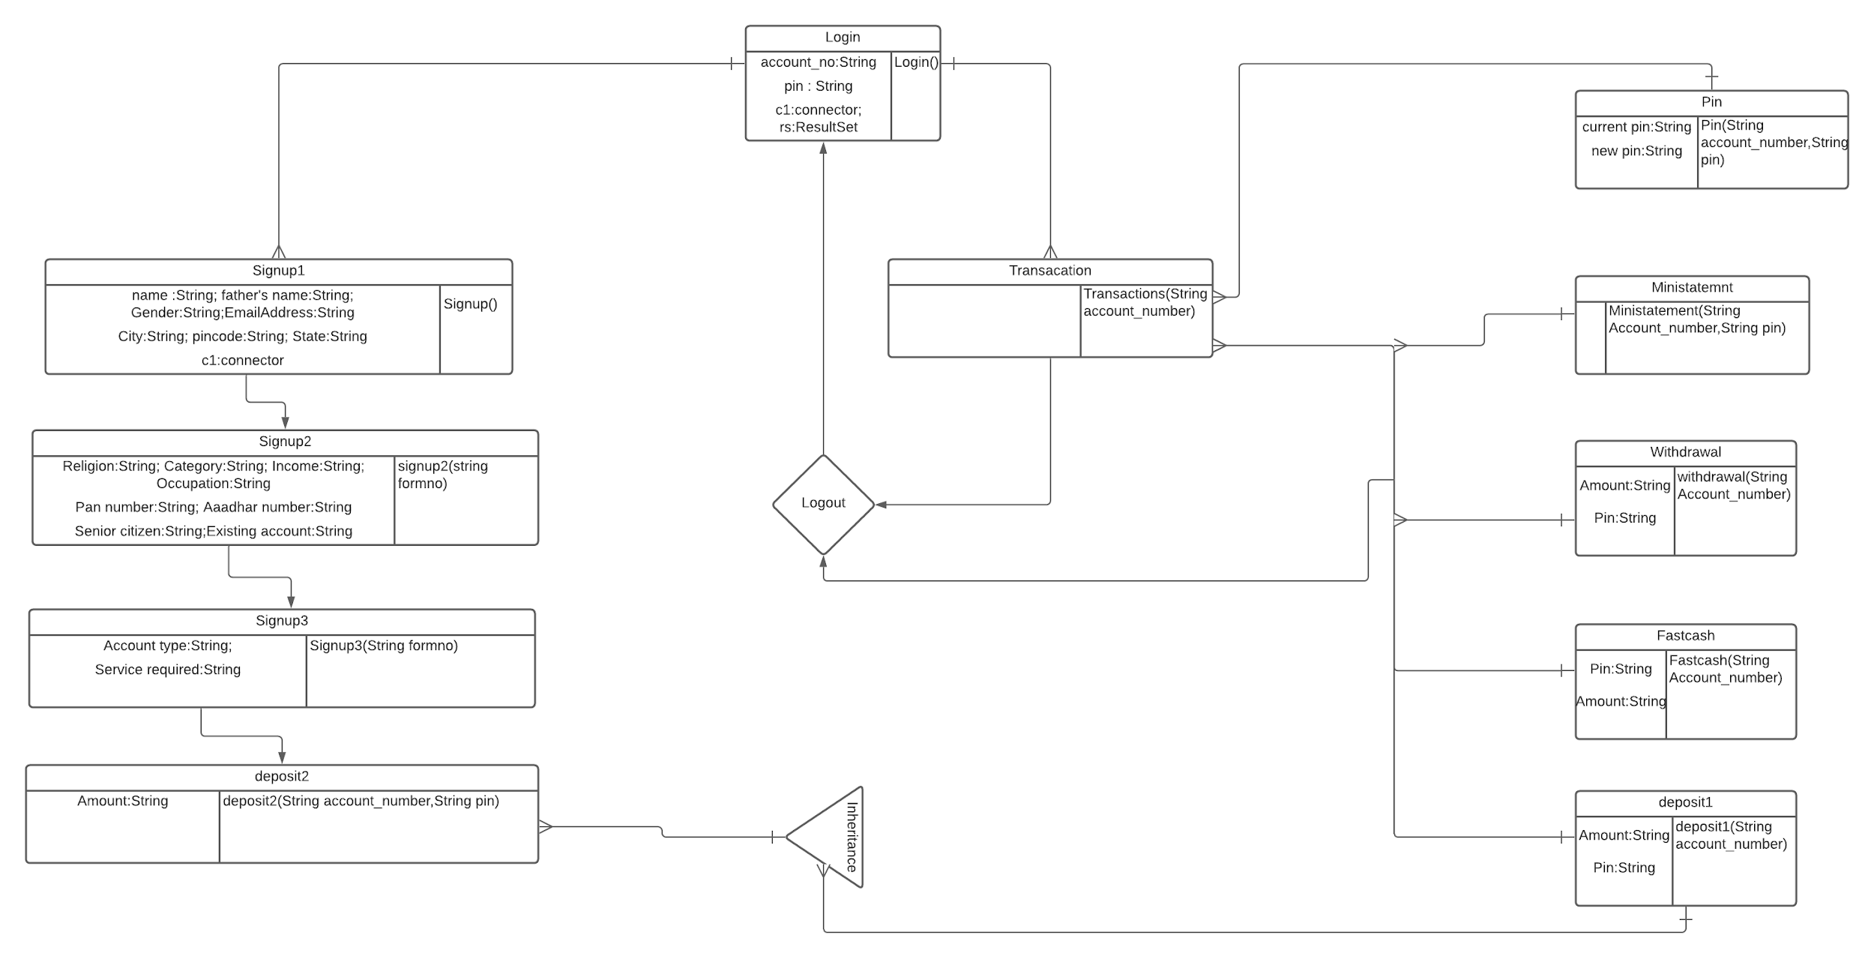
Class diagram

Slide 5
Classes and their relationship
1) jdbcConn
This class is used for making the connection between java code and our database using jdbc drivers . Whenever we want to use update insert delete or any such query related to our database ,then first we have to make a object of this class to create a connection and then using this objects variables we can execute our database queries.
2) Login
This class will check whether the user has entered correct details or not, if user has entered correct details then ,transactions class object will be created and then he will be able to perform the operations present in transaction class. If user is a new user ,then he can signup using signup button, as soon as signup button will be

Slide 6
clicked ,signup1 class object will be created.
Login page will check user details from login table present in our database
3) Transactions
Transaction class will allow user to perform various operation like deposit ,withdraw. After successfully logging in ,he will come to transactions page where he will get following operations:
Deposit
Withdraw
Fast Cash
Pin Change
Balance Enquiry
Mini Statement

Slide 7
Balance Enquiry is function is defined not in a separate class but is present inside transaction class.
If users want to know how much balance he has in his account, then he can use balance enquiry. Balance enquiry will go to transaction table and will check user’s latest balance and will display user’s balance in a pop up window.
He can also logout of the transactions page using logout button ,and after logging out he will again reach to login page.
4) Deposit (1)
This class can be called from transaction page and will be responsible for depositing the amount into user’s account.
At the time of depositing amount he will be asked to enter the correct pin, and then to check whether he has entered correct pin or not ,we will have to call jdbcClass object and then with the help of this object will look into our login table for the entered pin.

Slide 8
Entered money will be added into users balance in transaction table.
5) Withdraw
Using this class user can withdraw amount from his account.He can withdraw whatever amount he wishes to but that much amount should be present in his account, if he tries to withdraw amount more than his balance ,then he will get an insufficient balance message. This class first check user’s balance in our database and then allow him to withdraw money
Withdrawal amount will be deducted from user’s account balance in transaction table.

Slide 9
6) Fast Cash
If the user is in hurry and he wants money immediately ,then he may use this class. This class will give many options to withdraw money like :100 ,500, 1000. In such way by only clicking on the following option he will be able to withdraw money from his account and corresponding amount will be deducted from his balance in transaction details table
7) Pin Change
If users wishes to change his pin number , then he can go to pin change to change his pin number. He first has to entered his current pin and then he will be asked to entered a new pin. After successfully changing the pin ,his pin number will be updated in login table , transaction table.

Slide 10
8) Mini Statement
If users not only wants to know his balance but also wants to know on which date and time he has withdrawn and deposited his money ,then he can use mini statement. Mini Statement will allow user to see some of his last transactions along with date and time.
This class will use transaction table and will display his balance ,deposit amount ,withdraw amount and also his date time present in transaction table.
9) Signup1
If user is a new user or wants to create a new account then he can use this class. This is the first signup page where user will enter his personal details. After inserting his details, user can go to signup2 by clicking on next. As soon as next button is click ,all his entries will be entered into personalDetails table and signup2 class object will be created.

Slide 11
Clicking on cancel button on any of the signup page will delete all his details from bank which he has entered till now in signup pages and program will be ended.
10) Signup2
After coming from signup1 ,user have to enter some additional details. If user click back then ,signup1 object will be created and all the entries which user has entered in signup1 page will be deleted from personalDetails table. If user click on next button then signup3 class object will be created and all his additional details will be inserted into additionalDetails table.
11) Signup3
After coming from signup2 ,user has to enter some account related details like what facilities he want - cheque ,internet banking etc. After entering all account details ,if user click on next button he will be directed to deposit2 page by calling deposit2 class object and all his account details entries will be saved in accountDetails table. If he click on back button then he will be directed to signup2 page after deleting his entries from additionalDetails table.

Slide 12
12) Deposit2
This is the last page of registration. This class extends deposit1 class .After successfully entering all the details in all the three signup pages ,user will be asked to enter the amount. This amount should be more than equal to 3000. If he tries to enter the amount less than 3000 ,then he will be asked to enter the amount again. After successfully depositing the money ,his balance will be stored in transaction details table and his generated card number and pin will be displayed on the screen.

Slide 13
Database Tables
Our schema consists of 5 tables.
Login Table : It consists of the login details with card_number and pin as its columns.
Personal Details : It consists of the personal details of all the account holder. Its class is defined as signup1.
Account_no | pin
5040524179689756 | 4737

Slide 14
3. Additional Details: It consists of the additional details of all the account holder. Its class is defined as signup2.
4. Account Details: It consists of all the account details of all the account holder. Its class is defined as signup3.
formno | religion | category | income | education | occupation | pan_number | aadhar_number | senior | existing
2390 | Hindu | General | <1,50,000 | Post-Graduate | Self-employed | 657821358767 | 895642356892 | No | No
formno | account | Account_no | pin | service_required | Account_Start_Date
2390 | Saving Account | 5040524179689756 | 4737 | ATM Card Internet Banking Mobile Banking Cheque Book | 2020-11-27 00:36:57

Slide 15
5. Transaction Details: It contains the information about the money deposited or withdrawal and maintain the mini statement by maintaining the account balance.
Account_no | pin | deposit | withdraw | balance | date_time
5040524179689756 | 4737 | 9000 | 0 | 9000 | 2020-11-27 00:37:25

Slide 16
Jdbc Connection
try{ //Function for registering database drivers
Class.forName("com.mysql.cj.jdbc.Driver");
//Establishing the connection
c=DriverManager.getConnection("jdbc:mysql:///bank_management","root","lakshay452000"); //last 2 are username and password used for mysql
//this will be used to perform queries on database
s=c.createStatement();
}catch(Exception e){
System.out.println("Error connecting with database");
System.out.println("Error "+e); } } }

Slide 17
Exception Handling
Signup
try{ if(t6.getText().equals("")||a.equals("")||b.equals("")||e.equals("")||g.equals("")||h.equals("")||i.equals("")||j.equals("")){
JOptionPane.showMessageDialog(null, "Fill all the required fields");
}else if(d==null||f==null){
JOptionPane.showMessageDialog(null, "Gender and Martial Status fields are required");
}else{
jdbcConn c1 = new jdbcConn();
String q1 = "insert into PersonalDetails

Slide 18
values('"+a+"','"+b+"','"+ac+"','"+bc+"','"+cc+"','"+d+"','"+e+"','"+f+"','"+g+"','"+h+"','"+i+"','"+j+"','"+k+"','"+first+"')";
c1.s.executeUpdate(q1);
new Signup2(first+"").setVisible(true);
setVisible(false); }
}catch(Exception ex){
ex.printStackTrace();
System.out.println("Error "+e) } }
else if(ae.getSource()==b2) {
System.exit(0); }
} }

Slide 19
Exception Handling
Mini Statement
try {
ResultSet rs = c1.s.executeQuery(" SELECT * FROM TransactionDetails having Account_no ='"+Account_number+"' and pin ='"+pin+"' order by date_time DESC");
while(rs.next() && ++c<=28) {
temp=rs.getString("Account_no")+"\n";
s1+=temp;
temp=rs.getString("deposit")+"\n";
s2+=temp;

Slide 20
temp=rs.getString("withdraw")+"\n";
s3+=temp;
temp=rs.getString("balance")+"\n";
s4+=temp;
temp=rs.getString("date_time")+"\n";
s5+=temp; }
ta1.setText(s1);
ta1.setEditable(false);
ta2.setText(s2);
ta1.setEditable(false);
ta3.setText(s3);

Slide 21
ta1.setEditable(false);
ta4.setText(s4);
ta1.setEditable(false);
ta5.setText(s5);
ta1.setEditable(false);
}catch (Exception e) {
e.printStackTrace();
System.out.println("Error "+e);
}

Slide 22
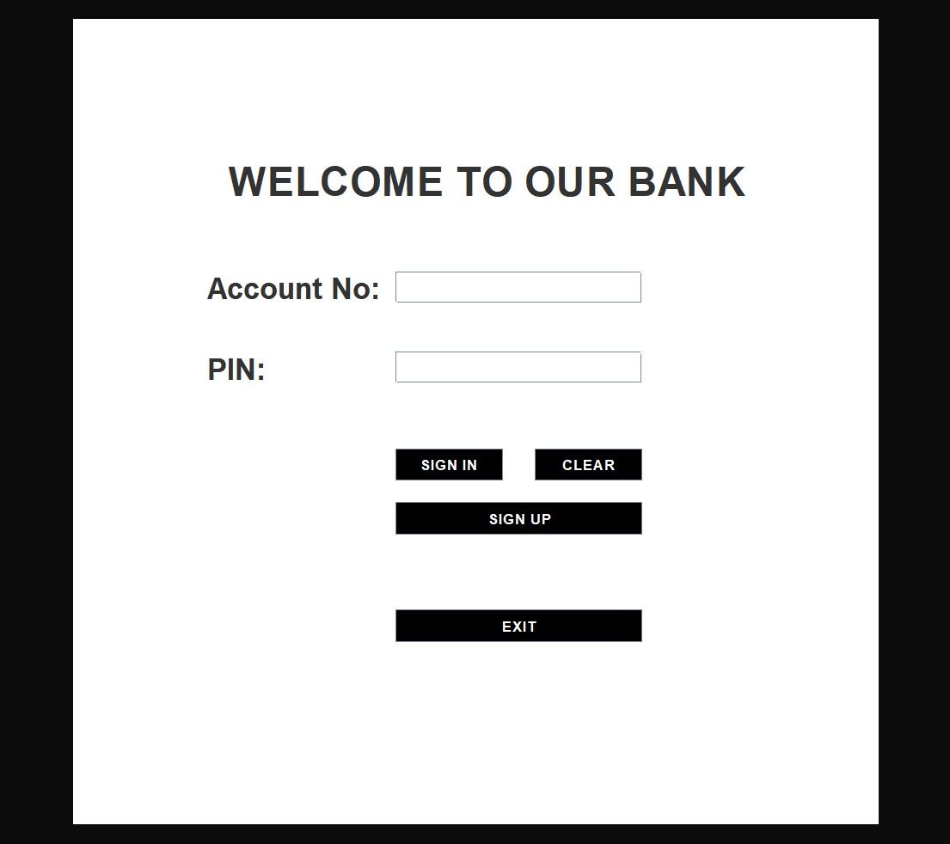
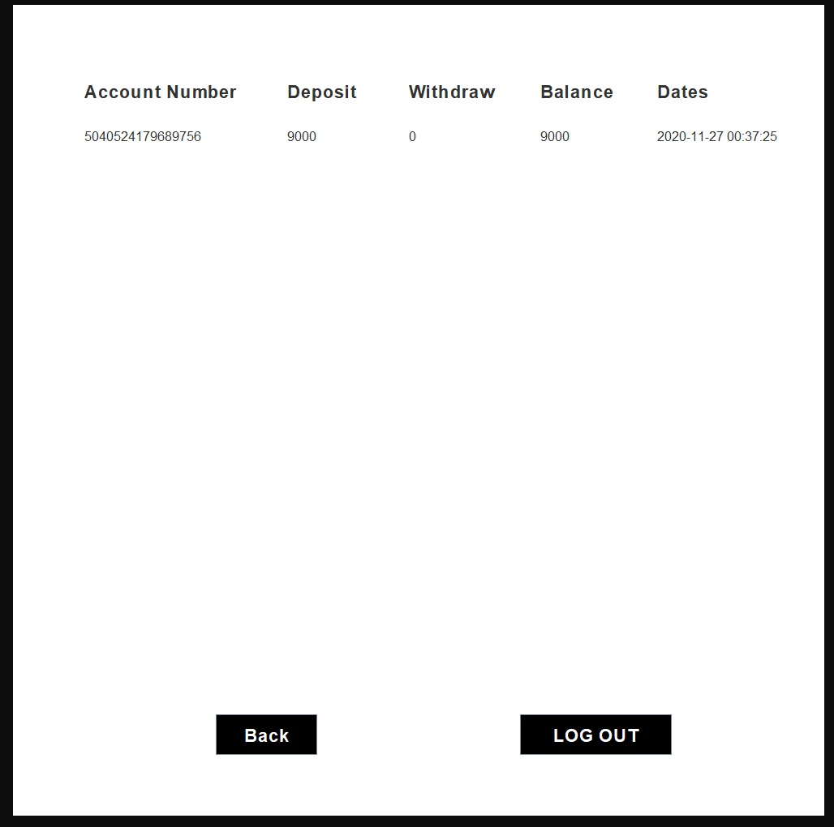
Output window
Log In Mini statement

Slide 23
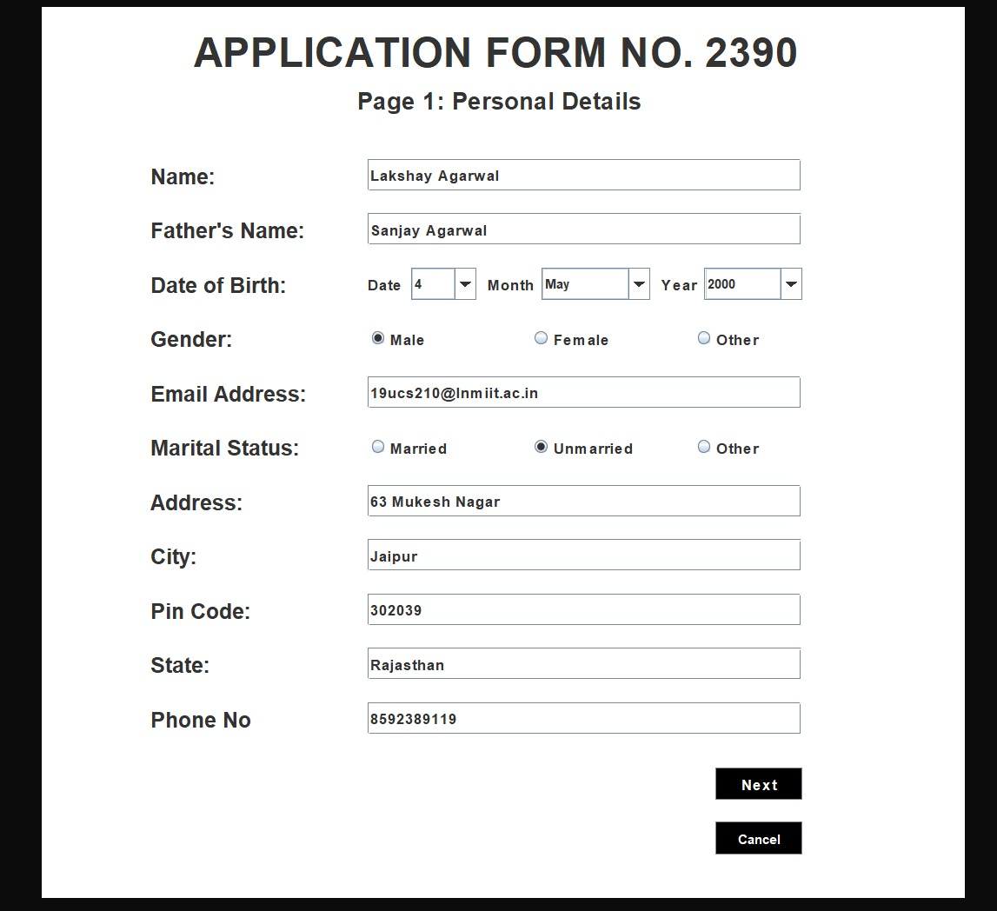
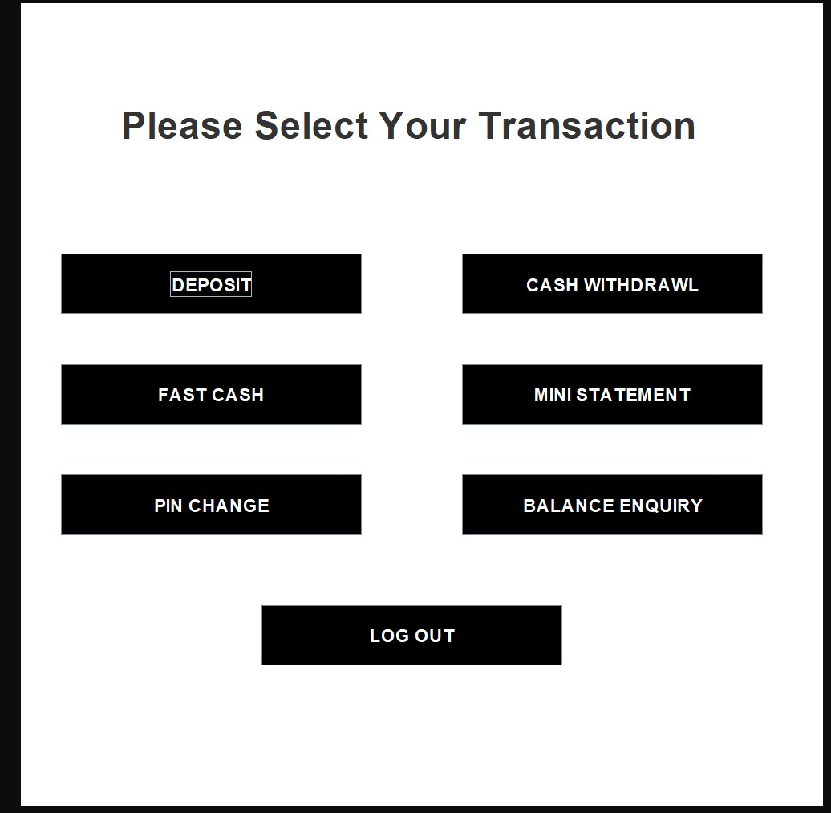
Sign Up Transaction

Slide 24
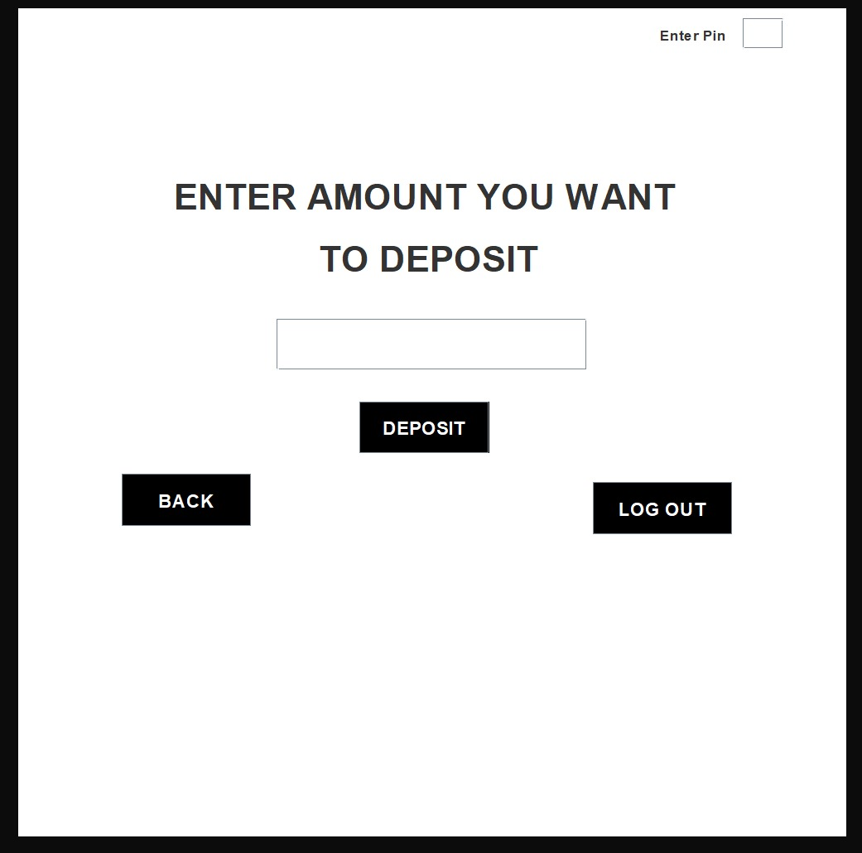
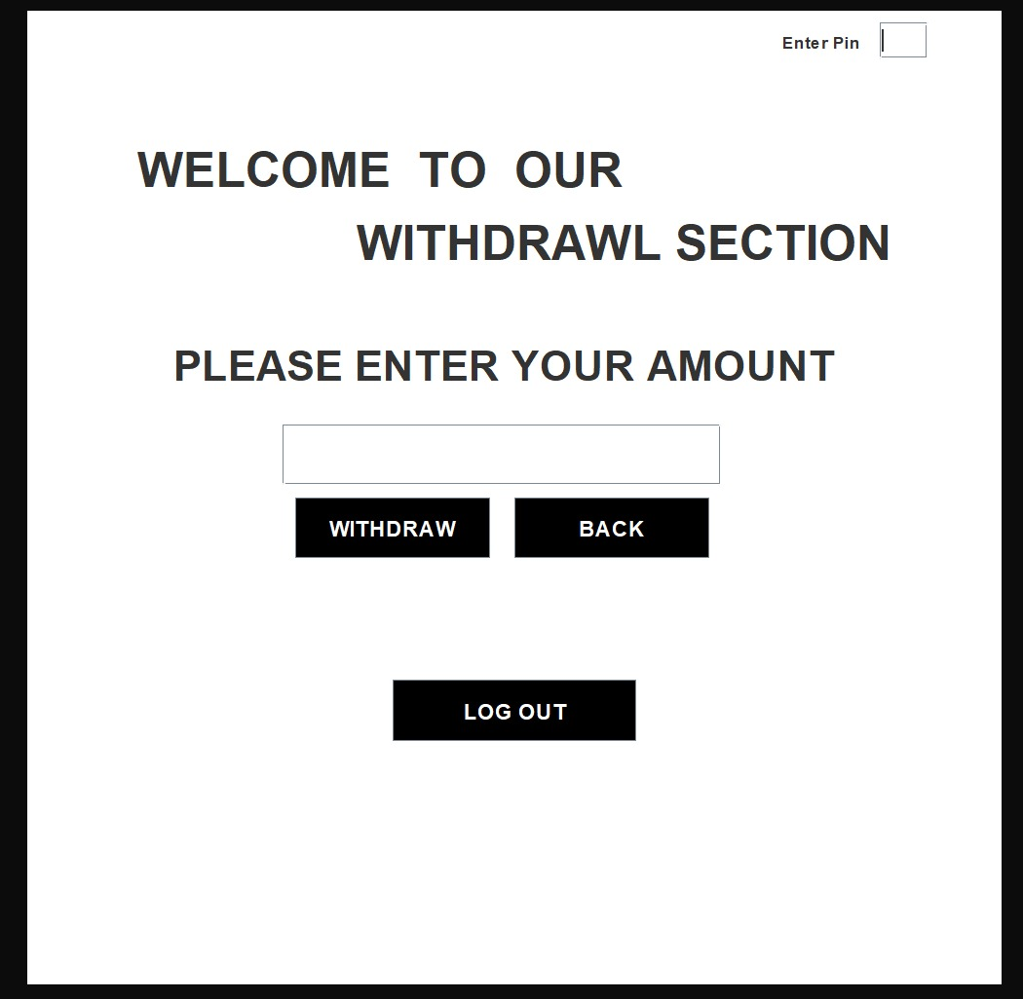
Deposit Withdrawl

Slide 25
Thank you

